Slide 1


Deep Learning and Acoustic Features for Emotion Detection
Presented by
CHANDRADIP ROY (202116003), WREET KHAREL (202116020), PIJUSH DAS (202116024)
Under the supervision of
Dr. Ranjit Panigrahi
Assistant Professor – SG, Department of Computer Application,
Sikkim Manipal Institute Technology, Sikkim Manipal University, Sikkim, India

Slide 2
Contents
Introduction
Aim and Objective
Feasibility Study
Literature Survey
Problem Definition
Proposed Solution Strategy
Project Plan
Software and hardware requirements, Team Structure, Gantt Chart
Data Collection
Data Augmentation
Data Preprocessing
Feature Extraction

Slide 3
Contents
Model Exploration & Analysis
Result Analysis of The Basic Model
Architecture of FractalCNN
Results of FractalCNN for RAVDESS( Gender Independent )
Results of FractalCNN for RAVDESS(Gender Dependent )
Results of FractalCNN for SAVEE
Results of FractalCNN for TESS
Comparison Between The Models
Comparative Analysis for RAVDESS
Comparative Analysis for SAVEE
Comparative Analysis for TESS
Conclusion
References

Slide 4
Introduction
01
Emotions play a significant role in human communication and relationships.
Extreme emotional imbalance can lead to many serious illnesses. These not only affect people's mental health but can also cause serious physical health issues.[1]
Emotion detection has various applications, including healthcare for diagnosis and treatment, human-machine interaction, etc.
Facial expressions and vocal cord vibration are the most significant biomarkers for emotion detection.
Deep learning, particularly deep neural network architecture like LSTM, CNN, and RNN can be used.

Slide 5
Aims and Objective
02
Aim:
This project aims to develop an efficient deep-learning model for human emotion detection through voice signals.
Objective:
To detect emotional states from a particular voice signal efficiently.
To recognize the user’s emotional state precisely.
To help in detecting a person’s particular health condition if they are suffering from a disease like Parkinson’s, clinical depression, etc..

Slide 6
General Overview of the Problem
02
In a world where healthcare is shifting to digital platforms, the way we interact with healthcare professionals is changing as well.
Imagine a situation where a patient calls their therapist on the phone. The therapist can’t see their face, making it difficult for them to understand the patient’s emotional state.
This is where the actual problem lies.

Slide 7
Feasibility Study
03
Technical Feasibility:
We are planning to use a variety of open-source resources for the development of the project, such as Python, librosa, google colab, RAVDESS, and TESS, which are all publicly available. Our team members are well-versed in these resources, making the project technically feasible.
Economic Feasibility:
To develop the project, all the required resources are open-source and freely available. Hence the project is also economically feasible.
Time-Line Feasibility:
We have a proper timeline for the development of this project, which includes activities like collecting data, preprocessing data, extracting features, and developing models, and the timeline is enough to complete the project within the specified timeframe. Hence, the project is time-feasible.

Slide 8
Literature Reviews
04
Author/ Article/ Journal | Methodology | Research Gaps | Relevance to the Work
D. Issa, M. Fatih Demirci, and A. Yazici, “Speech emotion recognition with deep convolutional neural networks,” Biomed. Signal Process. Control, vol. 59, p. 101894, May 2020, doi: 10.1016/j.bspc.2020.101894. [8] | This paper has proposed a 1D CNN and different audio features to develop an emotion detection model. | It would be beneficial if the proposed framework can be tested in additional datasets to assess its generalizability across different emotional speech datasets. | Uses feature extraction method.

Slide 9
Literature Reviews
05
Author/ Article/ Journal | Methodology | Research Gaps | Relevance to the Work
N. Patel, S. Patel, and S. H. Mankad, “Impact of autoencoder based compact representation on emotion detection from audio,” J. Ambient Intell. Humaniz. Comput., vol. 13, no. 2, pp. 867–885, Feb. 2022, doi: 10.1007/s12652-021-02979-3.[9] | This paper has shown the use of Autoencoders for dimensionality reduction. They have used two different datasets namely RAVDESS, TESS also three different classifier such as SVM, CNN, Decision Tree and they achived 4.66% improvement in RAVDESS dataset, and 2.616% improvement in TESS dataset. | Instead of using simple Autoencoders, the study could be done on more advance techniques such as Convolution Autoencoders. The study could also be conducted on various deep learning algorithms. | Dimensionality reduction technique.

Slide 10
Literature Reviews
06
Author/ Article/ Journal | Methodology | Research Gaps | Relevance to the Work
S. Lalitha, S. Tripathi, and D. Gupta, “Enhanced speech emotion detection using deep neural networks,” Int. J. Speech Technol., vol. 22, no. 3, pp. 497–510, Sep. 2019, doi: 10.1007/s10772-018-09572-8. [11] | They have proposed a DNN with three hidden layer which is used to classify seven emotions. They have used the Berlin speech emotion corpus. Also, they have investigated various feature extraction techniques such as MFCC, RPLP, BFCC, IMFCC , PLPC, MEPLPC,LPC & Fourier Parameters. | Class imbalance is not addressed | Data Augmentation technique

Slide 11
Problem Definition
07
In remote medical consultations, the most significant biomarker for emotion detection would not work.
In this case, we can consider another biomarker for emotion detection i.e. voice signals.
In this scenario, deep learning plays a crucial role, where we can use deep neural networks to develop such a model which can be used to predict human emotion detection.

Slide 12
Proposed Solution Strategy
08
We have considered using deep learning algorithms which will be used to design a model that can predict a human’s emotion.
For training purpose, we are using various publicly available emotional datasets.
We have also used 4 different data augmentation techniques for creating synthetic data.
Then we preprocessed the audio signals before feeding it into the model.
After preprocessing, we have extracted the essential features related to human emotion.
After extracting the features, we are feeding them into the deep learning model for training purpose.

Slide 13
Project Plan
09
Hardware Requirements:
Processor: AMD Ryzen 5 4000 Series
RAM: 8GB DDR4
Storage: 512 GB SSD
GPU: Nvidia GTX 16 series
Software Requirements:
Language: Python
I.D.E. : Jupyter Notebook, Spyder
Libraries:
Pandas
Numpy
scikit-learn
Matplotlib
Librosa
keras

Slide 14
Project Plan
10
Team Structure:
Dr. Ranjit Panigrahi
Wreet Kharel
Chandradip Roy
Pijush Das

Slide 15
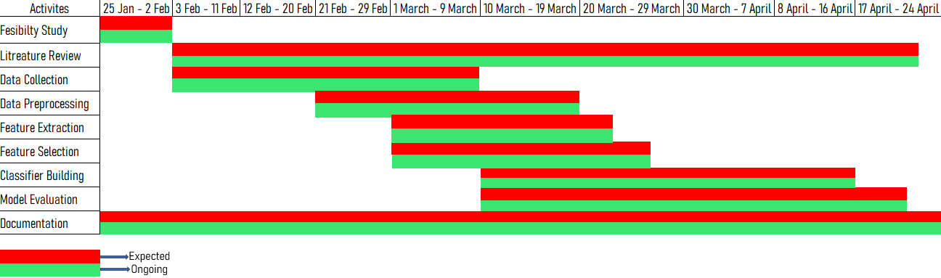
Project Plan
11
Gantt Chart:

Slide 16
Data Collection
12
Toronto emotional speech set (TESS): There are a set of 200 target words spoken in the carrier phrase "Say the word _' by two actresses (aged 26 and 64 years) and recordings were made of the set portraying each of seven emotions (anger, disgust, fear, happiness, pleasant surprise, sadness, and neutral). There are 2800 audio files in total.
Ryerson Audio-Visual Database of Emotional Speech and Song (RAVDESS): This dataset contains 7356 audio - video files. 24 professional actors acted by saying different sentences. It includes 8 different speech emotions such as calm, neutral, happy, sad, angry, fearful, disgust, and surprised.
Surrey Audio-Visual Expressed Emotion (SAVEE): This dataset contains 480 audio files which is used to express 7 different emotions such as neutral, happy, sad, angry, disgust, fearful, and surprised.

Slide 17
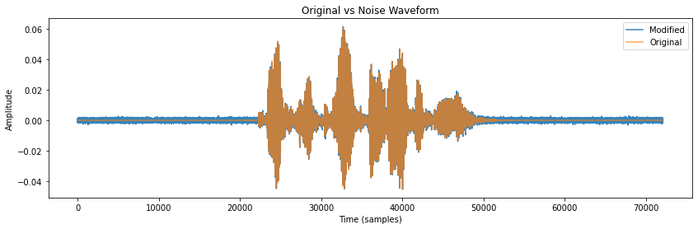
Data Augmentation
13
It is a process of creating synthetic data from the original data.
To create a diverse dataset, which can help the model for generalization.
We have used four different data augmentation techniques.
Noise Injection:
Random values from a normal distribution is inserted into the original waveform at a rate of 0.035.
Noised
Original

Slide 18
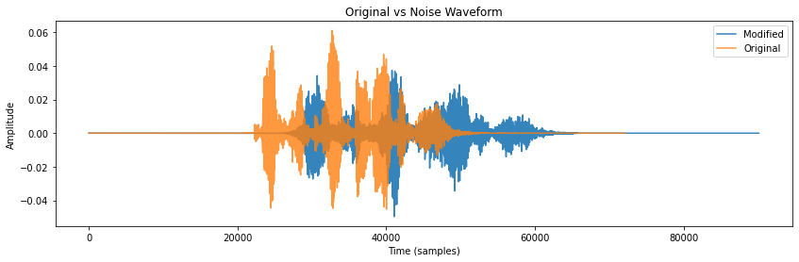
Data Augmentation
14
Time Stretching:
To stretch or compress the waveform in the time axis by a given rate.
By default, the rate is 0.8
“time_stretch” function of the librosa library is used.
Stretched
Original

Slide 19
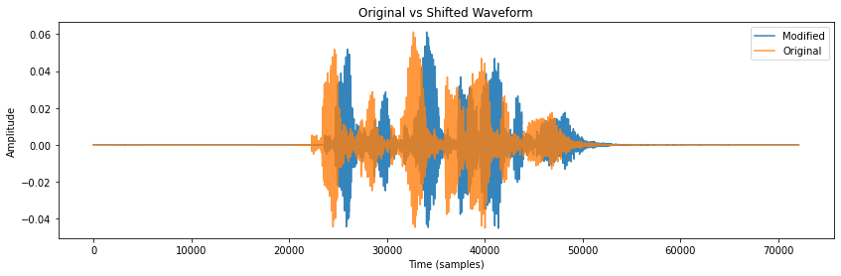
Data Augmentation
15
Time Shifting:
To shift the waveform by a random value.
The random value was calculated from a number between -4 and 4 of a uniform distribution then multiplying it by 1000 to convert it into milliseconds.
Positive value indicates that the waveform will be shifted to the right; else it will be shifted to the left.
Time Shifted
Original

Slide 20
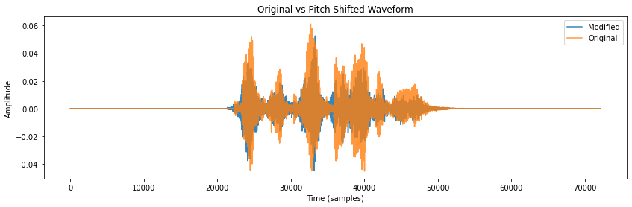
Data Augmentation
16
Pitch Shifting:
To add a pitch shift effect in the original waveform by a given factor.
“pitch_shift” function of the librosa library is used.
Pitch shifted
Original

Slide 21
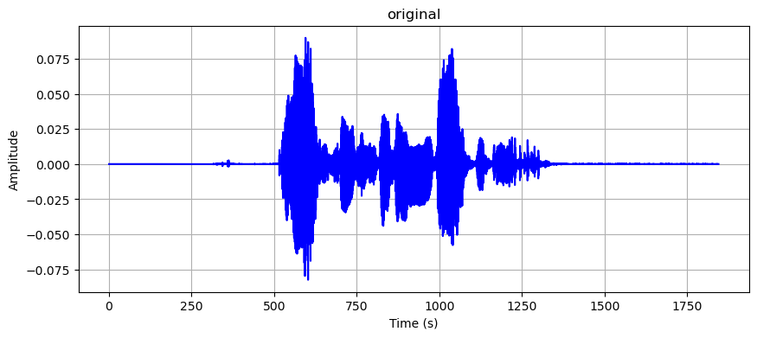
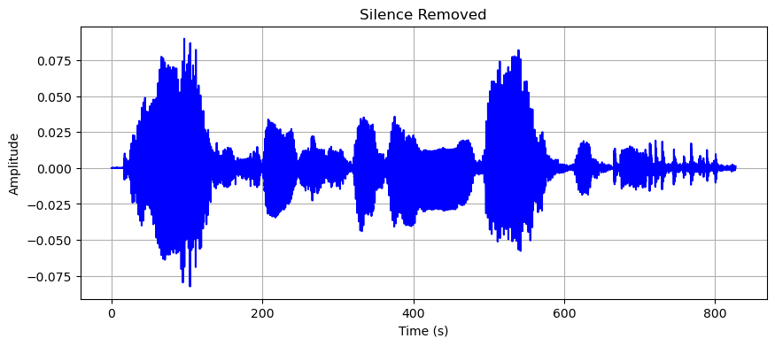
Data Preprocessing
17
Silence Removing: In the first of data preprocessing, we have removed the silence part from the audio based on a given threshold using a ‘envelop’ function.
Waveform of the original signal
Waveform of the modified signal

Slide 22
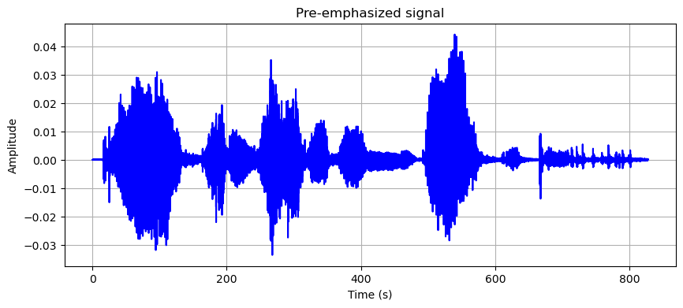
Data Preprocessing
18
Pre-emphasizing: In this step, the masked audio signal will be pre-emphasized. Pre-emphasizing is the process of modifying the audio signal (voice signal in this case). It is used to boost the higher frequencies of the signal relative to the lower frequencies.
Waveform of the pre-emphasized signal

Slide 23
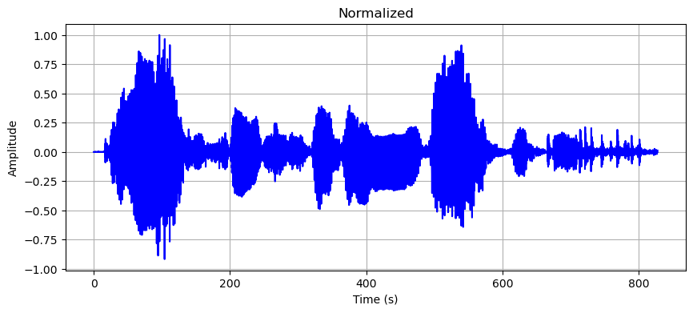
Data Preprocessing
19
Normalization: Once the signal is pre-emphasized, it is gone through another process called normalization. Normalization refers to the process of standardizing the volume of the sound.
Waveform of the normalized signal

Slide 24
Feature Extraction
20
MFCC : Mel Frequency Cepstral Coefficient or MFCC is widely used feature extraction processes particularly for the task like audio classification, speech recognition, music genre classification, and speaker identification. It includes the following processes:
Applying mel filter bank.
Converting the mel filtered signal in logarithmic scale.
Calculating ‘n’ number of DCT or Discrete Cosine Transform to the signal (where n is the total number of mfcc coefficients).
Linear Predictive Coding(LPC): Linear Predictive Coding is a widely used method in speech processing for modeling the spectral envelope of speech signals.
Chroma STFT: Chroma STFT or Short-Time Fourier Transformation is a method used in music and audio processing to represent the harmonic content or tonal quality of an audio signal over time.
Mel Spectrogram: Mel spectrogram is used to detect the higher energies in different frequencies.
Zero Crossing Rate: It is used to calculate how many times the signal crosses the zero amplitude within a certain period.
Root Mean Square: It provides the measures of the overall magnitude of the voice signal.

Slide 25
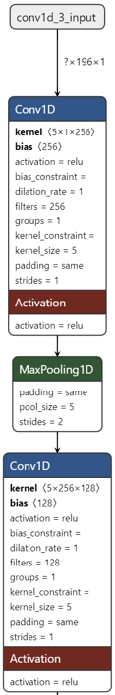
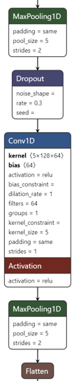
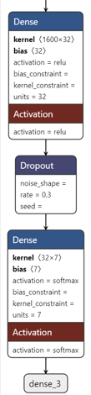
Model Exploration & Analysis
21
CNN:
CNN or Convolutional Neural Network is a type of deep learning algorithm that is mainly used for classification.
It consists of multiple layers, each layers consisting of filters (also called kernels).
After the convolutional layers, pooling layers are often used to reduce the spatial dimensions of the feature maps produced by the convolutional layers.
It uses activation functions such as ReLU, tanh, and softmax.

Slide 26
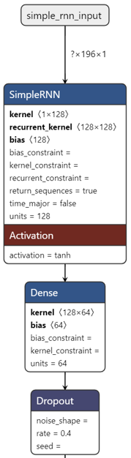
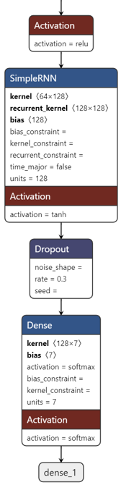
Model Exploration & Analysis
22
RNN:
RNN or Recurrent Neural Network is a type of deep learning algorithm that is designed to handle sequential data.
It mainly designed to handle time series or sequential data.
The main characteristic that makes it different from other neural networks is it’s Hidden State.

Slide 27
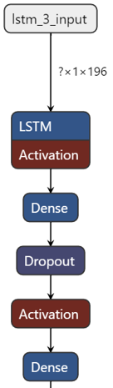
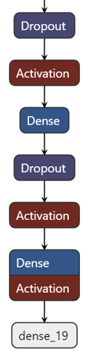
Model Exploration & Analysis
23
LSTM:
LSTM or Long-Short Term Memory is a type of recurrent neural network that is designed to mimic the neurons of the human brain.
It mainly designed to handle time series or sequential data.

Slide 28
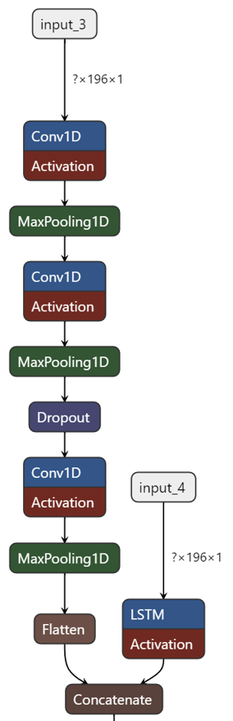
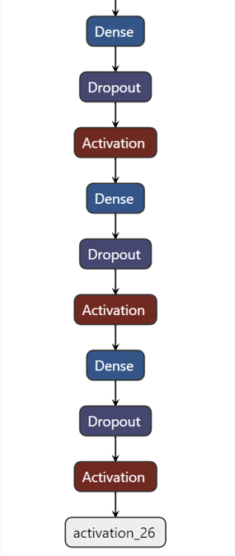
Model Exploration & Analysis
24
CNN with LSTM:

Slide 29
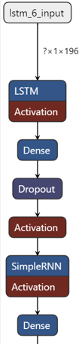
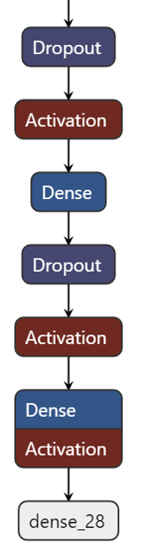
Model Exploration & Analysis
25
LSTM with RNN:

Slide 30
Result Analysis For The Basic Models
26
Results for TESS dataset:

Slide 31
Result Analysis For The Basic Models
27
Results for RAVDESS dataset:

Slide 32
Result Analysis For The Basic Models
28
Results for SAVEE dataset:

Slide 33
Architecture of FractalCNN
29
FractalCNN:
A deep convolutional neural network with 7 1-d convolutional layers.
Each of them have a kernel size of 8.
Each layers are followed by a batch normalization layer and dropout layer with a dropout rate of 0.5.
Each layers are using “relu” activation function.
The last layer is a fully connected layer which have total number of neurons same as the total number of class present in the dataset.
The last layer is using “softmax” activation function to calculate the probability of each emotion classes.

Slide 34
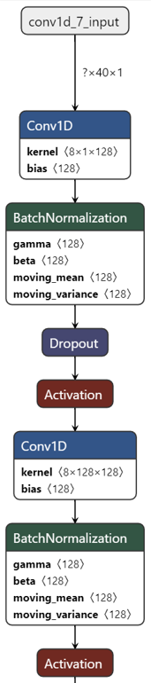
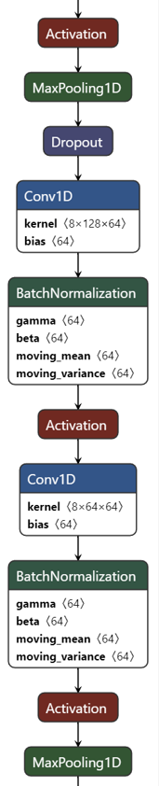
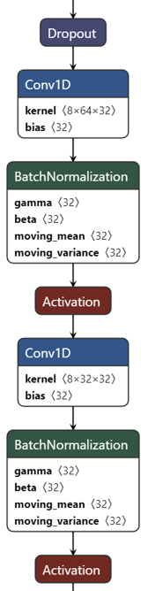
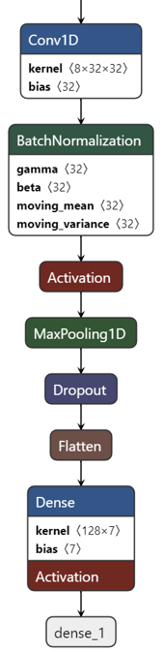
Architecture of FractalCNN
30

Slide 35
Results of FractalCNN for RAVDESS (Gender Independent)
31

Slide 36
Results of FractalCNN for RAVDESS (Gender Dependent)
32

Slide 37
Results of FractalCNN for SAVEE (Gender Independent)
33

Slide 38
Results of FractalCNN for TESS (Gender Independent)
34

Slide 39
Comparison Between The Models
35

Slide 40
Comparative Analysis For RAVDESS
36
Author’s Name | Features | Methodology | Accuracy(%)
Issa et al.[11] | Mel Spectrogram, Chromagram, Spectral Contrast, MFCC, Tonnetz, | 1-D CNN | 71.61
Alnuaim et al.[15] | MFCC, STFT, Mel Spectrogram | MLP | 81
Andayani et al. [16] | MFCC | LSTM-Transformer | 75.62
Kumaran et al.[17] | M-GFCC | Deep C-RNN | More than 80
Kakuba et al.[18] | MFCC, Chromagram, Mel Spectrogram | ABMD | 85.89
Dolka et al.[19] | MFCC | ANN | 88.72
Jahangir et al.[20] | Spectral contrast, tonnetz, MFCCS, delta-MFCCS, delta-delta MFCCS, and chromagram | 1-D CNN | 90.6
Li. et al.[31] | IMel Spectrogram, Mel Spectrogram | CNN-SSAE | 83.18
S. Bhattacharya et el.[32] | MFCC, Chroma, Tonnetz, Contrast, Mel Spectrogram | CNN | 90.86
M. Khan et al.[33] | - | DeepESN, Dilated CNN, Multi-Headed Attention Mechanism, Sparse Random Projection | 82.01 (Speaker-dependent)
 |  |  | 77.02 (Speaker-independent)
This work (Gender Neutral) | Mel Spectrogram | FractalCNN | 91
 | MFCC |  | 92
 | Combined |  | 93
This work (Gender Specific male and female) | Mel Spectrogram | FractalCNN | 95
 | MFCC |  | 92
 | Combined |  | 94

Slide 41
Comparative Analysis For SAVEE
37
Author’s Name | Features | Methodology | Accuracy(%)
Kakuba et al.[18] | MFCC, Chromagram, Mel Spectrogram | ABMD | 93.75
Dolka et al.[19] | MFCC | ANN | 86.80
Li. Et al.[31] | Mel Spectrogram Imel Spectrogram | CNN-SSAE | 88.96
Jahangir et al.[20] | Spectral contrast, tonnetz, MFCCS, delta-MFCCS, delta-delta MFCCS, and chromagram | 1-D CNN | 93.75
R. Singh et al.[34] | MFCC, pitch, zcr, rms | SVM | 77.38
S. Mishra et al.[35] | MRVMMFCC, MRVMAE, MRVMPE | DNN | 83.4
K. Mountzouris et al. [36] | MFCC | CNN+ATN | 74
M. H. Saeed et al. [37] | MFCC, Mel Spectrogram, Chroma, Poly Feature | DNN | 90
Yanlin Liu et al.[38] | Fundamental Frequency, ZCR, Chroma, MFCC, Mel Spectrogram, Spectral Contrast, Spectral Centroid | CNN-A-LSTM | 94.5
Li et al. [39] | Log Mel Spectrogram | DeepCNN | 92.97
This Work | Mel Spectrogram | FractalCNN | 95
 | MFCC |  | 91
 | Combined |  | 95

Slide 42
Comparative Analysis For TESS
38
Author’s Name | Features | Methodology | Accuracy(%)
Dolka et al.[19] | MFCCS | ANN | 99.52
Tellai et al. [21] | MFCC, Mel Spectrogram | CNN-Transformer | 99.42
Choudhary et al.[40] | MFCC | CNN | 97.1
Huang et al. [41] | MFCC | 2-D CNN | 85
This Work | Mel Spectrogram | FractalCNN | 100
 | MFCC |  | 100
 | Combined |  | 100

Slide 43
Conclusion
39
We are proposing a deep convolutional network named as “FractalCNN”.
We have extracted various features from the audio signal which includes MFCC, LPC, Chroma STFT, Zero crossing rate, and Root Mean Square.
Two experiments were conducted during the project development.
First experiment is mainly conducted to identify the best feature that we can use for our final experiment.
In second experiment, the best features were fed into the “FractalCNN” individually for each datasets.
The model has achieved 100% accuracy on TESS dataset for both the features individually as well as combined.
For gender independent experiment, the model has achieved 91%, 92%, and 93% accuracy on Mel spectrogram, mfcc, and combined, respectively in RAVDESS.
For gender dependent experiment, the model has achieved 95%, 92%, and 94% accuracy on Mel spectrogram, mfcc, and combined, respectively in RAVDESS.
Achieved 95%, 91%, and 95% accuracy on Mel spectrogram, mfcc, and combined, respectively in SAVEE.

Slide 44
References
40
[1] B. Müller-Oerlinghausen, A. Berghöfer, and M. Bauer, “Bipolar disorder,” Lancet, vol. 359, no. 9302, pp. 241–247, Jan. 2002, doi: 10.1016/S0140-6736(02)07450-0.
[2] B. T. Litz, S. M. Orsillo, D. Kaloupek, and F. Weathers, “Emotional processing in posttraumatic stress disorder.,” J. Abnorm. Psychol., vol. 109, no. 1, pp. 26–39, Feb. 2000, doi: 10.1037/0021-843X.109.1.26.
[3] F. Vancheri, G. Longo, E. Vancheri, and M. Y. Henein, “Mental Stress and Cardiovascular Health—Part I,” J. Clin. Med., vol. 11, no. 12, p. 3353, Jun. 2022, doi: 10.3390/jcm11123353.
[4] S. R. Livingstone and F. A. Russo, “The Ryerson Audio-Visual Database of Emotional Speech and Song (RAVDESS): A dynamic, multimodal set of facial and vocal expressions in North American English,” PLoS One, vol. 13, no. 5, p. e0196391, May 2018, doi: 10.1371/journal.pone.0196391.

Slide 45
References
41
[5] R. Cowie et al., “Emotion recognition in human-computer interaction,” IEEE Signal Process. Mag., vol. 18, no. 1, pp. 32–80, 2001, doi: 10.1109/79.911197.
[6] K. Bhangale and M. Kothandaraman, “Speech Emotion Recognition Based on Multiple Acoustic Features and Deep Convolutional Neural Network,” Electronics, vol. 12, no. 4, p. 839, Feb. 2023, doi: 10.3390/electronics12040839.
[7] G. Tzanetakis and P. Cook, “Musical genre classification of audio signals,” IEEE Trans. Speech Audio Process., vol. 10, no. 5, pp. 293–302, Jul. 2002, doi: 10.1109/TSA.2002.800560.
[8] D. Issa, M. Fatih Demirci, and A. Yazici, “Speech emotion recognition with deep convolutional neural networks,” Biomed. Signal Process. Control, vol. 59, p. 101894, May 2020, doi: 10.1016/j.bspc.2020.101894.
[9] N. Patel, S. Patel, and S. H. Mankad, “Impact of autoencoder based compact representation on emotion detection from audio,” J. Ambient Intell. Humaniz. Comput., vol. 13, no. 2, pp. 867–885, Feb. 2022, doi: 10.1007/s12652-021-02979-3.

Slide 46
References
42
[10] S. Langari, H. Marvi, and M. Zahedi, “Efficient speech emotion recognition using modified feature extraction,” Informatics Med. Unlocked, vol. 20, p. 100424, 2020, doi: 10.1016/j.imu.2020.100424.
[11] S. Lalitha, S. Tripathi, and D. Gupta, “Enhanced speech emotion detection using deep neural networks,” Int. J. Speech Technol., vol. 22, no. 3, pp. 497–510, Sep. 2019, doi: 10.1007/s10772-018-09572-8.
[12] B. M. Nema and A. A. Abdul-Kareem, “Preprocessing signal for Speech Emotion Recognition,” Al-Mustansiriyah J. Sci., vol. 28, no. 3, pp. 157–165, Jul. 2018, doi: 10.23851/mjs.v28i3.48.
[13] Z. Yang and Y. Huang, “Algorithm for speech emotion recognition classification based on Mel-frequency Cepstral coefficients and broad learning system,” Evol. Intell., vol. 15, no. 4, pp. 2485–2494, Dec. 2022, doi: 10.1007/s12065-020-00532-3.
[14] J. K. Das, A. Ghosh, A. K. Pal, S. Dutta, and A. Chakrabarty, “Urban Sound Classification Using Convolutional Neural Network and Long Short Term Memory Based on Multiple Features,” in 2020 Fourth International Conference On Intelligent Computing in Data Sciences (ICDS), IEEE, Oct. 2020, pp. 1–9. doi: 10.1109/ICDS50568.2020.9268723.

Slide 47
References
43
[15] A. Ustubioglu, B. Ustubioglu, and G. Ulutas, “Mel spectrogram-based audio forgery detection using CNN,” Signal, Image Video Process., vol. 17, no. 5, pp. 2211–2219, Jul. 2023, doi: 10.1007/s11760-022-02436-4.
[16] M. N. Ram, Rashmirekha and Palo, Hemanta Kumar and Mohanty, Emotion recognition with speech for call centres using LPC and spectral analysis. 2013.
[17] T. F. Quatieri, Discrete-time Speech Signal Processing: Principles and Practice. 2002.
[18] N. Lora, Sanzana Karim and Sakib, Nazmus and Antora, Shahana Alam and Jahan, A comparative study to detect emotions from tweets analyzing machine learning and deep learning techniques}. 2020.

Slide 48
THANK YOU

